Slide 1

Hack JKLU
v4.0
Crime Mapping and Predictive Analysis System for Enhanced Policing
WebSmiths

Slide 2


Problem Statement:
Develop an intelligent crime mapping and analysis interface that integrates FIR data to visualize crime hotspots using color-coded maps based on parameters such as date, time, and crime type. Enhance the system with predictive analytics to identify criminal behavior patterns, factoring in seasonal trends and socio-economic influences to forecast potential crime occurrences. Automate patrol route planning for optimized resource deployment, strategically position patrols to enhance women's safety, and detect accident-prone areas using datasets like iRAD and CCTNS. Implement role-based access control to safeguard sensitive documents, ensuring secure and efficient law enforcement operations focused on proactive crime prevention.
iRAD and CCTNS stands for :
iRAD (Integrated Road Accident Database): A system developed by the Indian government to collect and analyze road accident data. It helps in identifying accident-prone areas and improving road safety measures.
CCTNS (Crime and Criminal Tracking Network & Systems): A nationwide database in India that connects police stations for real-time access to crime and criminal records, improving investigation and law enforcement efficiency.

Slide 3
System Architecture:
System Modules of the Intelligent Crime Mapping & Analysis Interface
1. Data Integration Layer
Aggregates and processes data from FIRs, iRAD, CCTNS, and socio-economic datasets for comprehensive crime and accident analysis.
Ensures real-time data synchronization, improving the accuracy of crime predictions and hotspot detection for proactive law enforcement actions.
2. Analytics Engine
Uses AI/ML algorithms to analyze historical crime data, detect patterns, and generate predictive insights for future crime occurrences.
Factors in seasonal trends, socio-economic conditions, and past criminal behavior to enhance crime forecasting and risk assessment accuracy.
3. Visualization Dashboard
Provides an interactive user interface displaying crime trends, hotspots, and predictive crime zones using color-coded maps and graphs.
Allows law enforcement to filter data by crime type, time, location, and severity, enabling data-driven decision-making for proactive policing.
4. Patrol Optimization Module
Automates patrol route planning by analyzing crime density, time-based risk factors, and geographic vulnerabilities for strategic deployment.
Enhances women’s safety by identifying high-risk zones and positioning law enforcement units at the most critical locations.
5. Access Control Module
Implements role-based authentication to restrict access to sensitive law enforcement data, ensuring only authorized personnel can view classified information.
Maintains data security standards, logs user activity, and prevents unauthorized data access for improved accountability and protection.

Slide 4
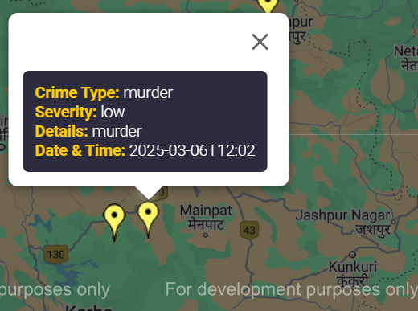
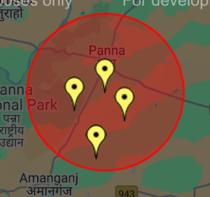
Key Features
Crime Hotspot Mapping:
Input Data
Visualization
Tools
Patrol Route Optimization:
Input Data
Algorithms
Output
Women's Safety Enhancements:
Input Data
Features
Accident-Prone Area Identification:
Input Data
features
Role-Based Access Control:
Input Data
Features
Crime hotspot mapping
with all the details
Danger zone has been shown over area with high risks

Slide 5
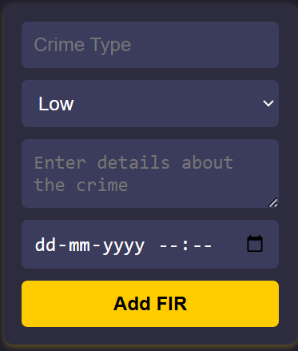
1. Crime Hotspot Mapping:
Input Data:
Integrates FIRs (date, time, location, crime type) and data.
Visualization:
Uses heatmaps to visually represent crime density, helping law enforcement quickly identify high-risk zones and allocate resources efficiently.
Implements color-coded hotspots based on severity: Red (high-crime areas), Yellow (moderate), Green (low-crime zones) for better risk assessment.
Tools:
Integrates mapping libraries like Folium or Leaflet for creating interactive, real-time crime maps with user-friendly interfaces.
Integrates FIRs , after filling up all the given details

Slide 6
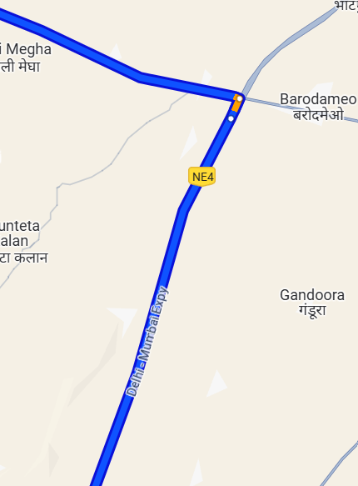
2. Patrol Route Optimization:
Input Data:
Uses real-time crime data.
Shows traffic conditions, emergency response time to ensure faster police intervention in critical areas.
Algorithms:
Implements optimization techniques such as Genetic Algorithms, Dijkstra's Algorithm, and A Algorithm* for the most efficient patrol path planning.
Output:
Generates dynamic patrol routes, updated in real-time, ensuring police are always positioned based on the latest crime activity.
Enhances strategic patrol unit placement by using predictive analytics, ensuring increased security presence in crime-prone and high-risk zones.
By using crime data maps the most efficient time saving routes

Slide 7
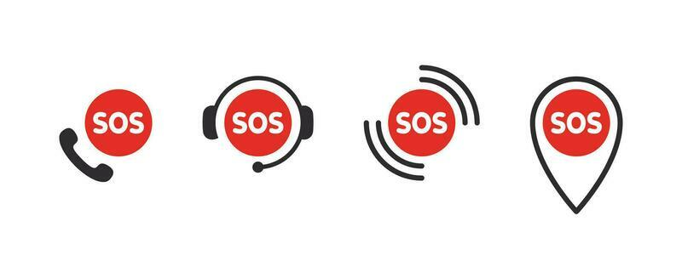
3.Women's Safety Enhancements:
Input Data:
Utilizes crime data specific to women (e.g., harassment, assault cases).
Incorporates public transport hubs, high-footfall areas, and emergency service locations to enhance surveillance and rapid response times.
Features:
Detects and maps unsafe zones, providing recommendations for increased patrol presence, improved lighting, and CCTV installations.
Integrates with mobile safety apps to provide real-time alerts, emergency SOS features, and location tracking for quick police assistance.
SOS features and location tracking for quick police assistance

Slide 8
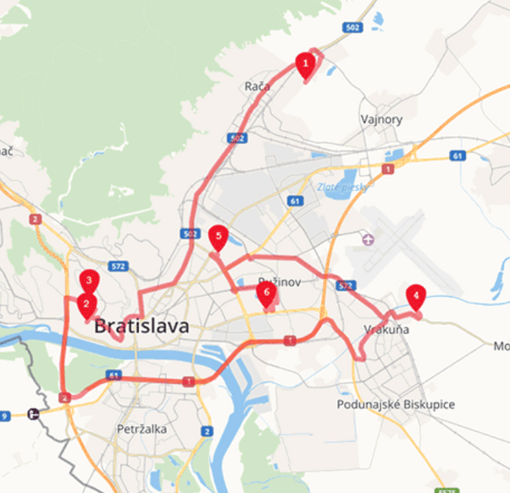
4.Accident-Prone Area Identification:
Input Data:
iRAD (accident data), traffic density, and road conditions.
Features:
Highlight accident-prone areas on the map.
Suggest preventive measures like traffic signals or speed breakers.
5. Role-Based Access Control
Input Data:
User roles (e.g., admin, officer, analyst).
Features:
Restrict access to sensitive documents and insights based on roles.
Use encryption and authentication mechanisms for secure access.

Slide 9
What it does?
Predictive Crime
Analytics
Real-Time Crime
Monitoring Dashboard
AI-Powered Suspect Identification
Community Policing Portal
Use machine learning models to predict crime hotspots based on historical data, seasonal trends, and socio-economic factors.
Provide actionable insights for proactive policing.
Enables police to allocate resources more effectively.
Reduces response times by anticipating crime-prone areas.
Display real-time crime data on an interactive dashboard.
Include filters for crime type, location, and time.
Provides a centralized platform for monitoring ongoing incidents.
Improves situational awareness for decision-makers.
Integrate facial recognition and object detection to identify suspects from CCTV footage or images.
Match suspects against criminal databases.
Speeds up the identification process.
Enhances accuracy in suspect tracking.
Allow citizens to report crimes, upload evidence (e.g., photos, videos), and provide tips anonymously.
Enable two-way communication between police and the community.
Builds trust between law enforcement and the public.
Encourages community involvement in crime prevention.

Slide 10


Crime Trend Analysis and Reporting
Training and Knowledge Hub
Generate detailed reports on crime trends (e.g., monthly, yearly, or location-wise).
Use data visualization tools (e.g., charts, graphs) to present insights.
Aids in strategic planning and policy-making.
Identifies long-term patterns and emerging threats.
Offer online training modules for police officers (e.g., cybercrime investigation, community policing).
Provide access to case studies, best practices, and legal resources.
Improves the skills and knowledge of law enforcement personnel.
Keeps officers updated on the latest trends and technologies.
What it
does?
Disaster and Emergency Management
Women's Safety Features
Provide tools for managing natural disasters, riots, and other emergencies.
Include real-time updates, evacuation routes, and resource allocation.
Improves preparedness and response during crises.
Saves lives and minimizes damage.
Provide a dedicated SOS button for women in distress.
Integrate with GPS to send real-time location to nearby patrol units.
Highlight safe zones and unsafe areas on the map.
Enhances safety for women in public spaces.
Builds confidence in the police force.

Slide 11
What it does?
Multi-Agency Collaboration Platform
Gamification for Training
Blockchain for Evidence Integrity
Public Awareness Campaigns
Enable seamless collaboration between police, fire departments, hospitals, and other agencies.
Share real-time data and coordinate responses.
Improves coordination during emergencies.
Ensures a unified approach to public safety.
Use gamification techniques to train police officers in decision-making and crisis management.
Simulate real-life scenarios for practice.
Makes training engaging and effective.
Prepares officers for high-pressure situations.
Use blockchain technology to securely store and verify evidence.
Ensure tamper-proof records for legal proceedings.
Enhances the credibility of evidence.
Simplifies the legal process.
Use the platform to run awareness campaigns on crime prevention, safety tips, and legal rights.
Include interactive quizzes and infographics.
Educates the public and reduces crime rates.
Builds a safer and more informed community.

Slide 12

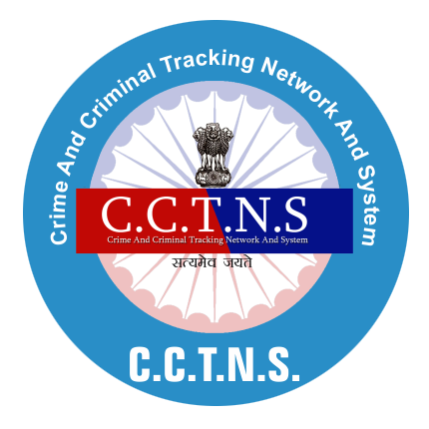
Call to Action
Aligns with India’s Digital India and Smart Cities missions.
Addresses urgent needs for safety and efficiency.
Positions your force as a leader in tech-driven policing.
Technical Backbone
CCTNS: Nationwide FIR and criminal data repository.
iRAD: Accident data for road safety insights.
GIS & AI: Real-time mapping and route optimization.
Secure Cloud: Role-based access with encryption.
Benefits for Law Enforcement
Faster response times with optimized routes (e.g., "Reduce travel time by 20-30%").
Proactive crime prevention through data-driven patrol planning.
Enhanced women’s safety with targeted resource allocation.
Reduced accidents by focusing patrols on iRAD-identified hotspots.
Improved efficiency with automated FIR analysis and secure data access.

Slide 13
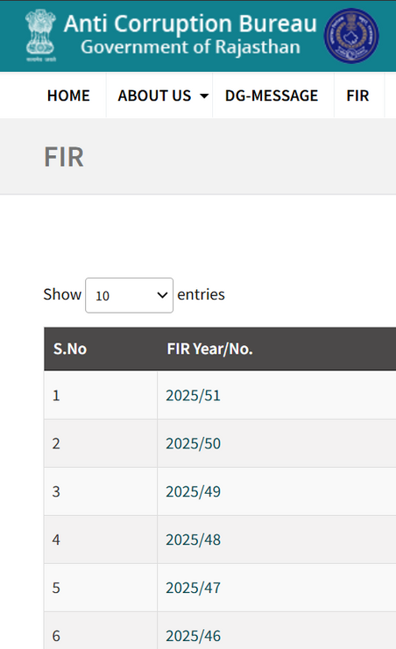
Records Management System
A police records management system (RMS) is a software program that stores and manages law enforcement data. RMS can help police agencies manage records like arrest records, incident reports, and evidence.
How does an RMS help police?
Centralized database:
An RMS stores records in a single database that is easy to search and access.
Reporting:
An RMS can generate reports and support multiple reporting mechanisms.
Mobile record generation:
An RMS can generate and store records on mobile devices.
Automation:
An RMS can automate everyday processes, reducing human error.
Integration:
An RMS can integrate with other law enforcement software, such as Computer-Aided Dispatch and evidence management systems
https://home.rajasthan.gov.in/content/homeportal/en/acbdepartment/Fir-by-year.html

Slide 14

Public Safety Cloud
A cloud-based system designed to support law enforcement, emergency response, and disaster management agencies. It provides scalable infrastructure for crime analysis, real-time surveillance, predictive policing, and secure data sharing.
For your Crime Mapping and Predictive Analysis System, integrating a Public Safety Cloud can enhance:
Real-time crime data processing (e.g., using AWS, Azure, or Google Cloud).
Secure storage for FIRs, CCTV footage, and reports.
AI-based crime trend prediction.
Collaboration between police, fire, and emergency teams.
Role-based access for officers, analysts, and administrators.
Public Safety Cloud

Slide 15
Computer-Aided Dispatch
Computer-Aided Dispatch (CAD) software is a crucial system used by police and emergency responders to manage, track, and dispatch resources efficiently. It integrates real-time incident data, GPS tracking, communication tools, and analytics to enhance response times and situational awareness.
Core Features of a Police CAD System
Incident Management 📌
Log crime reports and emergency calls.
Assign priority levels to incidents.
Track real-time status updates.
Automated Dispatch & Routing 🚓
Assign officers based on proximity and availability.
Provide optimized route navigation using GIS.
Use AI to predict response times and suggest units.
Live GPS Tracking & Unit Status 🛰️
Monitor officer locations in real-time.
Display available, busy, or out-of-service units.
Integrate with patrol cars and body cams.
Emergency Call Integration (112, 911, etc.) 📞
Directly receive emergency calls.
Automate data entry from calls and mobile apps.
Identify caller location automatically.
5.Crime Mapping & Predictive Analytics 📊
Visualize crime trends on a map.
Identify high-crime areas for proactive patrols.
Integrate with CCTNS, iRAD, and FIR databases.
6.Role-Based Access Control (RBAC) 🔒
Officers, dispatchers, and analysts get different access levels.
Protect sensitive case files and reports.
7.Automated Reporting & Documentation 📜
Auto-generate FIRs and crime reports.
Track case progress and evidence.
Export data for analytics & legal purposes

